Slide 1
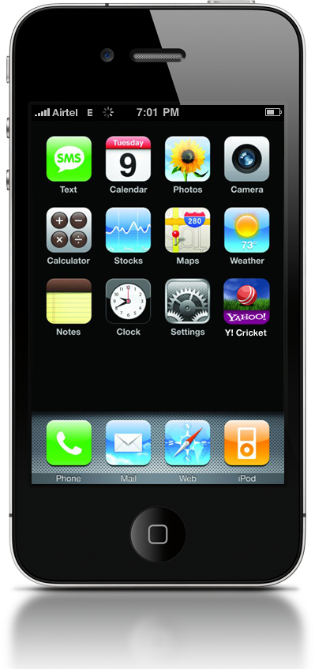
iPhone
User Interface Design Essentials
MOBILE DEVELOPER CONFERENCE, 2011, BANGALORE
Saturday, January 22, 2011

Slide 2
Biju
Damodharan
Harshad
Kulkarni
Yahoo! India UED
Designs products for global and regional audience which are used across devices
Saturday, January 22, 2011

Slide 3
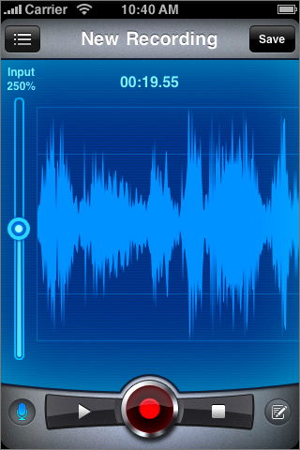
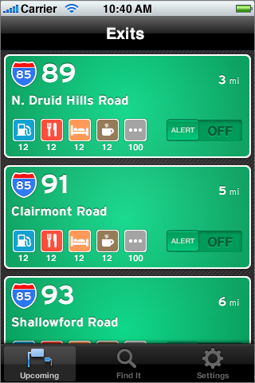
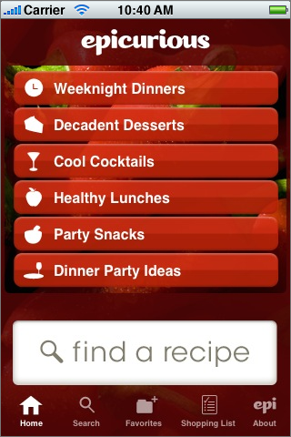
Tapparatus
Bestexit
Epicurious
Saturday, January 22, 2011

Slide 4
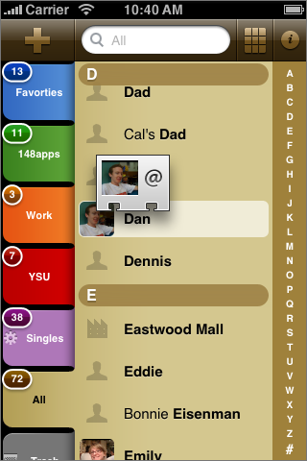
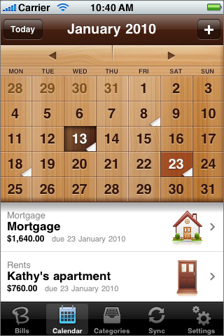
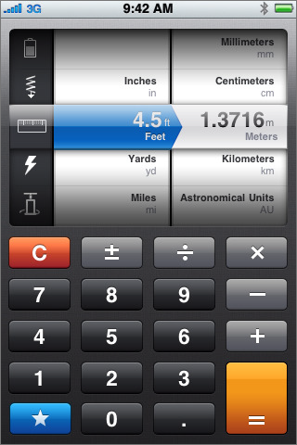
Guidedways
Powerybase
Convert
Saturday, January 22, 2011

Slide 5
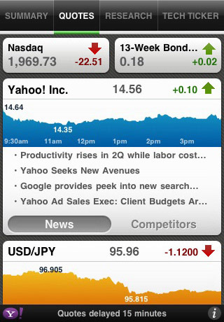
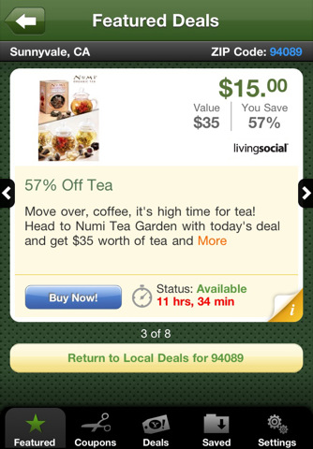
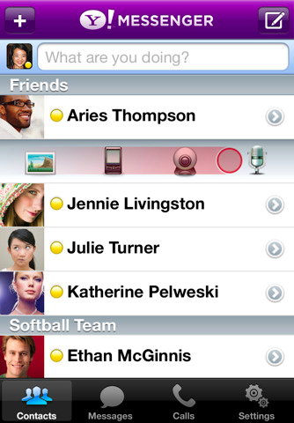
Yahoo! Finance
Yahoo! Deals
Yahoo! Messenger
Saturday, January 22, 2011

Slide 6
Know your Application Type
Design for iPhone
Development Environment
Interface Builder
Saturday, January 22, 2011

Slide 7
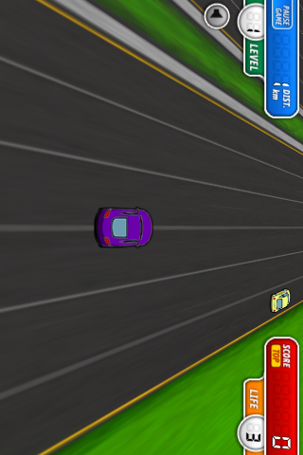
Know Your Application
Productivity Applications
Utility Applications
Immersive Applications
Saturday, January 22, 2011

Slide 8
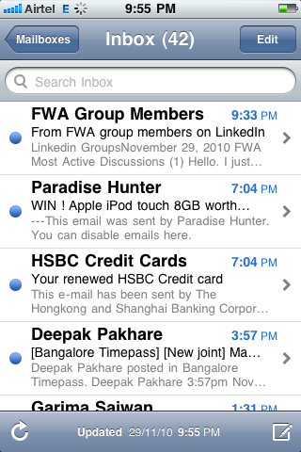
Productivity Application
Organize and manipulate information
User experience is focus on task.
Help user to quickly find what is needed, perform necessary action
Tend to organize information hierarchically
High usage of native elements and interactions
Saturday, January 22, 2011

Slide 9
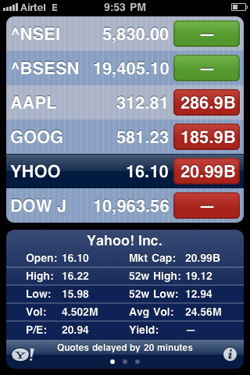
Utility Application
Visually attractive
Minimum user input
Quick summary of information
Filters to sort information
Saturday, January 22, 2011

Slide 10
Immersive Application
Fun application
Full screen visual rich environment
Simple Tasks
Hides device UI and has custom UI
Quick summary of information
Saturday, January 22, 2011

Slide 11
Choosing The Style
Based on type of information and tasks it enables,
choose appropriate style
Saturday, January 22, 2011

Slide 12
Product Definition Statement
Helps to turn list of features into a coherent product
It is a tool used to determine suitability of features and terminology
Saturday, January 22, 2011

Slide 13
Know Your Audience
Experience/Novice, Specific Task/Entertainment, Serious or Casual
Users are mobile
Quickly open the application and see useful content immediately
Perform tasks in just few taps
Saturday, January 22, 2011

Slide 14
Lets Create PDS
Saturday, January 22, 2011

Slide 15
Design for iPhone
It is a small 320x480 pixel screen (163ppi)
The size of a fingertip is 44x44 pixels
Mind your gestures and animation
Delight with stunning graphics, add realism
Minimum required input
Express information briefly
Saturday, January 22, 2011

Slide 16
1. Small Screen
One of the longest standing issues in Web design has been the "everything including the kitchen sink problem”
On a 1024x768 screen there's lots of pixels to fill!
Saturday, January 22, 2011

Slide 17
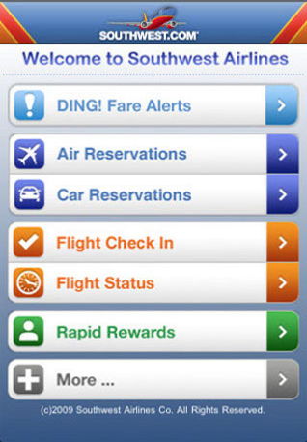
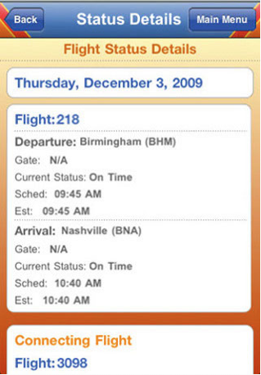
1. Small Screen
With 80% less screen space, you should know what matters most
The app should have a laser-like focus on what customers need and no room for anything else
Saturday, January 22, 2011

Slide 18
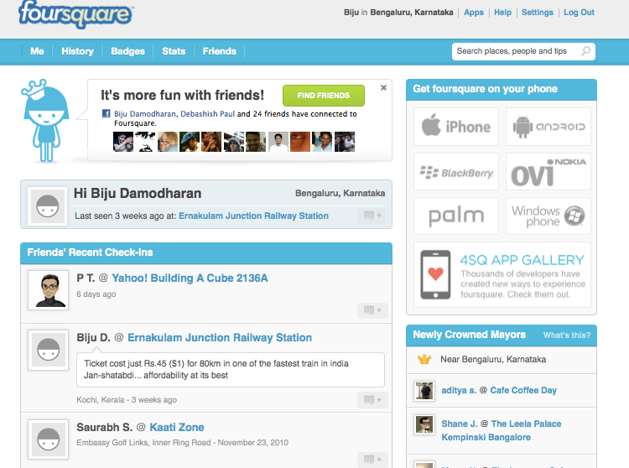
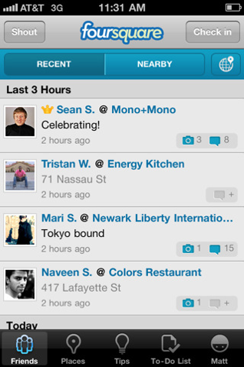
1. Small Screen
Saturday, January 22, 2011

Slide 19
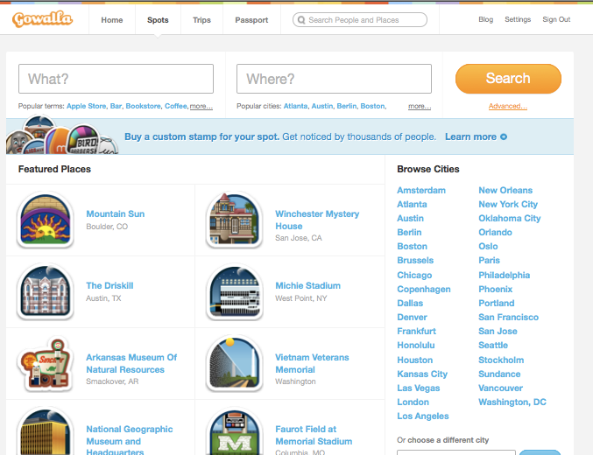
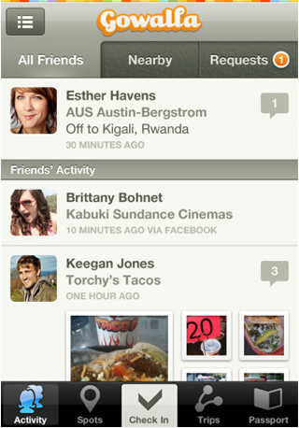
1. Small Screen
Saturday, January 22, 2011

Slide 20
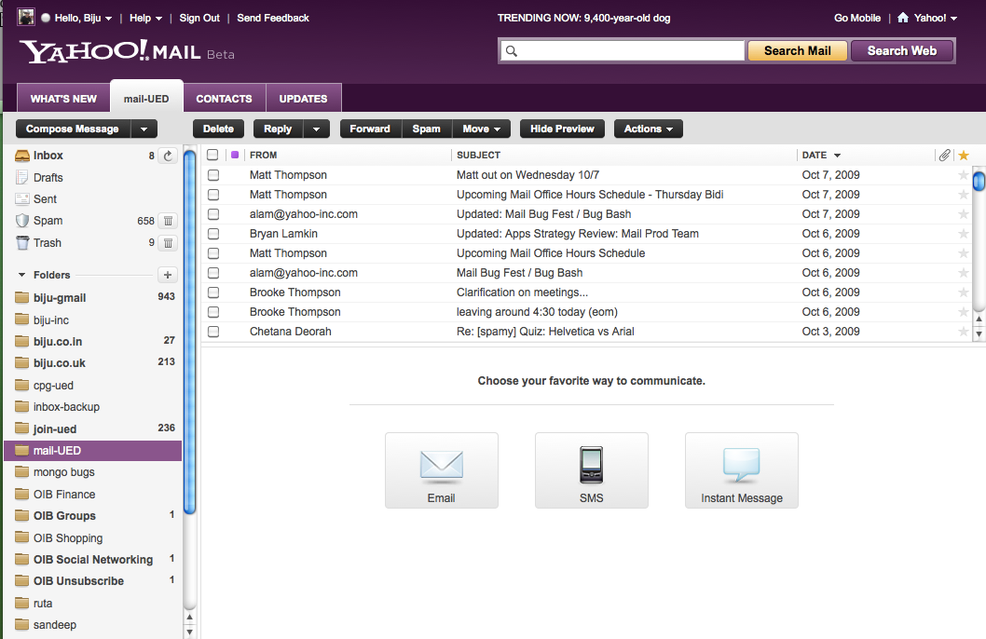
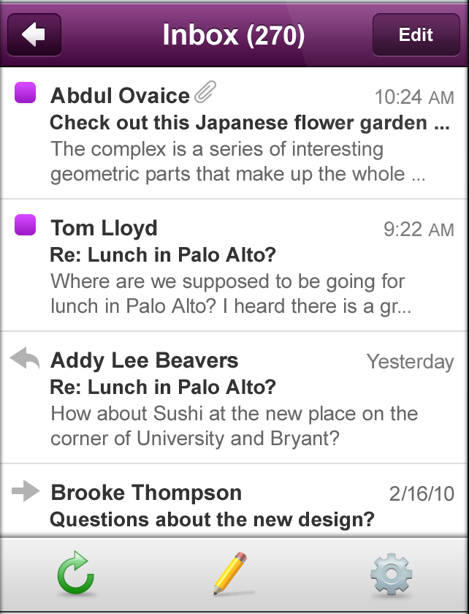
1. Small Screen
Saturday, January 22, 2011

Slide 21
1. Small Screen
App should be instantly understandable
Main function should be immediately apparent
Minimize the number of controls
Saturday, January 22, 2011

Slide 22
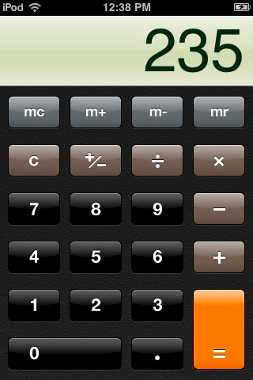
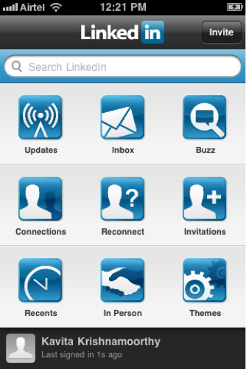
2. Fingertip Targets
The average cursor size is 16x16 pixels, but the average size of your fingertip is 44x44 pixels
Give tappable elements in your application a target area of about 44x44 pixels
Saturday, January 22, 2011

Slide 23
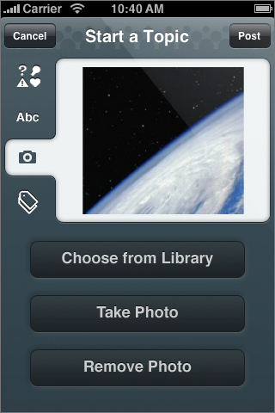
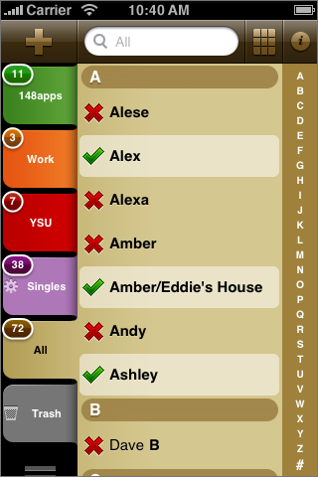
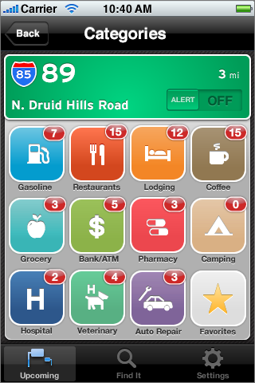
2. Fingertip Targets
Saturday, January 22, 2011

Slide 24
2. Fingertip Targets
Do not create targets lesser than 44x44 pixels
Do not place them too close together
If the UI is frequently touched then larger the better
Saturday, January 22, 2011

Slide 25
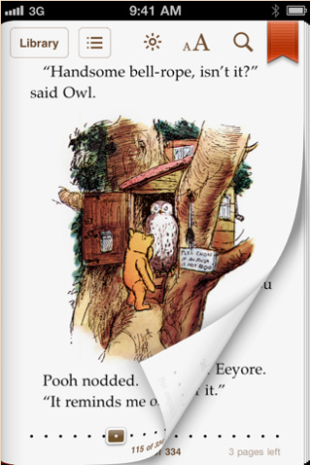
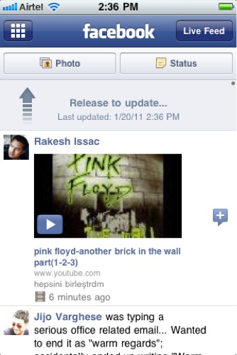
3. Animation & Gestures
Animation is a great way to communicate effectively, as long as it doesn’t get in the way of users
Animation can communicate status, provide useful feedback, and help people visualize the results of their actions
Saturday, January 22, 2011

Slide 26
3. Animation & Gestures
Saturday, January 22, 2011

Slide 27
3. Animation & Gestures
Saturday, January 22, 2011

Slide 28
3. Animation & Gestures
Add animation cautiously, especially in applications that do not provide an immersive experience
Use subtle animation used in the built-in iOS applications
Use animation consistently throughout your app
Saturday, January 22, 2011

Slide 29
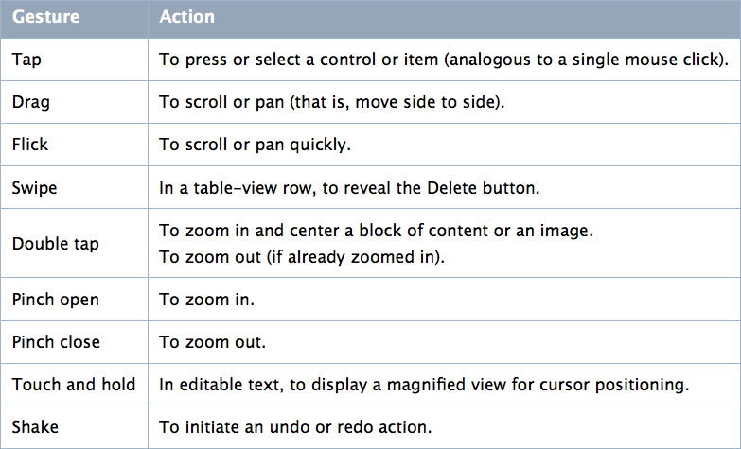
3. Animation & Gestures
Saturday, January 22, 2011

Slide 30
3. Animation & Gestures
Use complex gestures as shortcuts to expedite a task
Avoid associating different actions with the standard gestures users know
In general, avoid defining new gestures
Saturday, January 22, 2011

Slide 31
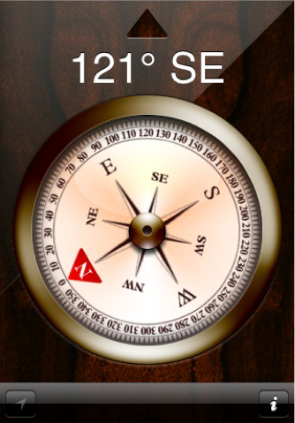
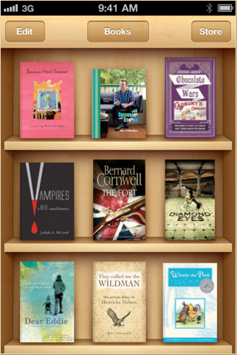
4. Graphics & Realism
Saturday, January 22, 2011

Slide 32
4. Graphics & Realism
When appropriate, add a realistic, physical dimension to your application.
The more true to life your application looks and behaves, the easier it is for people to understand how it works and the more they enjoy using it.
Saturday, January 22, 2011

Slide 33
5. Minimum Required Input
Small screen requires lot of attention to input information
Text field vs. pickers
Saturday, January 22, 2011

Slide 34
6. Express Information Briefly
Short and Direct
Real life/world metaphors
Saturday, January 22, 2011

Slide 35
Dev Environment
Naming Conventions
Regular: <ImageName><device_modifier>.<filename_extension>
High resolution: <ImageName>@2x<device_modifier>.<filename_extension>
Image format
32 bit png and 24 bit png
Interface Builder
Saturday, January 22, 2011

Slide 36
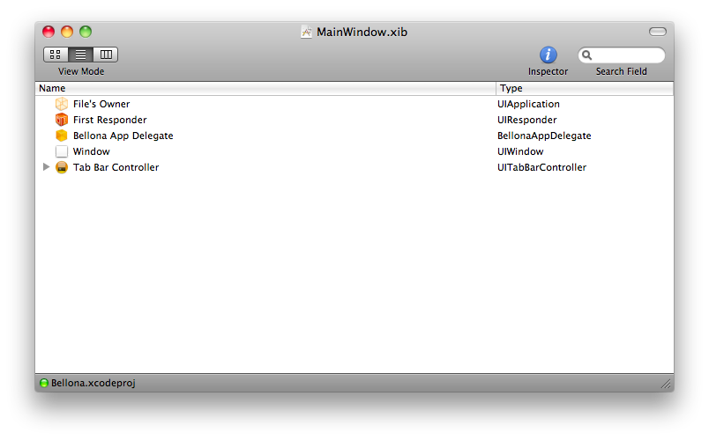
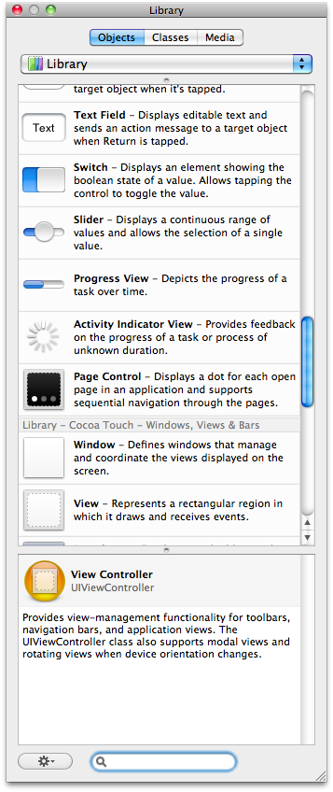
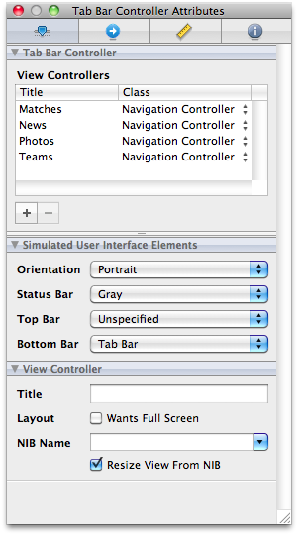
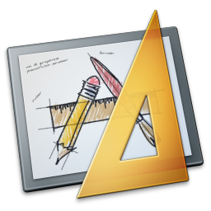
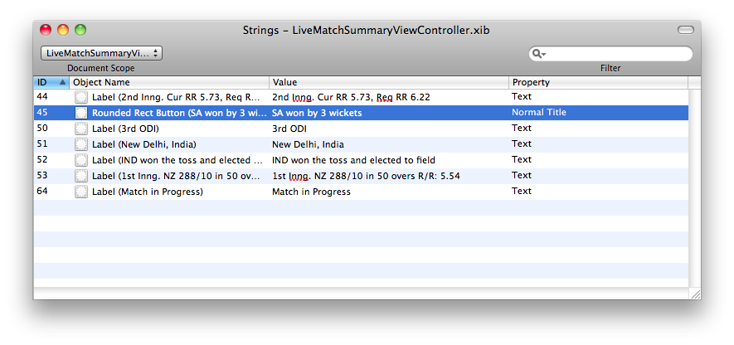
Saturday, January 22, 2011

Slide 37
References
MobileHIG
LUKEW Ideation + Design
Tapfancy
mobile.yahoo.com/iPhone
Saturday, January 22, 2011

Slide 38
Thanks
Saturday, January 22, 2011

